Slide 1
Teradici Cloud Access Software
Technical Brief
Last Updated: June 2020

Slide 2
Why Cloud Access Software?
High Performance User Experience
The industry’s highest image quality with build-to-lossless and full color accuracy. Automatically delivers best user experience under changing network conditions.
Ultra-Secure Architecture
PCoIP traffic is secured with strong AES 256 encryption; combined with stateless
zero clients to provide the most secure, easy to manage endpoints.
Ease of Deployment
Lightweight, simple, easy to deploy solution with brokering, provisioning and endpoint management included. It just works.
Widest Platform Flexibility
Supports Windows and Linux GPU and non-graphics applications, virtualized and physical machines, ESXi, KVM and AHV hypervisors, major public clouds and a broad range of SDKs and APIs for customization.

Slide 3
Teradici History of Innovation and Disruption
2004
13 Million+
Revolutionized the industry with
ultra-secure PCoIP® protocol
PCoIP endpoints worldwide
Leaders of Secure Virtual Workspaces
Major Technology Partners
Customers include Fortune 500 enterprises and institutions
We work with partners that provide our offerings to end users everywhere

Slide 4
Market Leadership
The PCoIP protocol has long been adopted as the remote solution of choice for high performance graphics or secure desktops in several sectors:
Media and Entertainment applications including visual effects, animation video editing, game development, video logging, mobile studios, playout automation and Keyboard-Video-Mouse (KVM) extenders
Governments demanding ultra high security solutions including smart card
access to standard or graphics Linux and Windows desktops
CAD/CAM/AEC/Automotive including manufacturing and engineering applications demanding high accuracy visualization and graphics processing
Linux Desktops for IT, software developers, HPC and scientific applications
Finance and business applications

Slide 5
Protocol Leadership
PCoIP FEATURE | BENEFIT
Build-to-Lossless (BTL) Image Quality | Fidelity of color, text, lines and textures is critical to achieving high productivity with CAD, design and video editorial applications
Color Accuracy | Visual Effects (VFX) artists and content reviewers can rest assured that the full color gamut is accurately reproduced
Highest Fidelity – on any network | Delivers the highest user experience for underlying conditions; from perceptually lossless LAN performance thru network-efficient H.264 WAN performance
Most Efficient Multi-codec Pipeline for High Frame Rates | Multi-threaded AVX2 CPU acceleration or NVIDIA NVENC GPU acceleration supporting 4K/UHD high frame rate applications
Endpoint Security | Highest security stateless zero- and thin client endpoints supporting up to 500 Mega-pixels-per-second ; low power footprint and near-zero IT maintenance
Wacom Device Experience Acceleration | Local termination for a broad range of Wacom Cintiq and Intuos pen displays and tablets offers artists seamless interaction with creative applications independent of latency to the data center

Slide 6
Competitor Comparison
PROTOCOL FEATURE | PCoIP | Other Protocols
Lossless text, fine lines and textures
RGB Build-to-lossless color accuracy
CPU (AVX2) and GPU (NVENC) acceleration
Low bandwidth H.264 for WAN video
Robust UDP over high latency lossy networks |  | Require low throughput FEC modes
High frame rates to 60 FPS
Low latency stateless zero clients
Wacom device acceleration on Window/Linux/Zero Client
White-label integration via SDKs and APIs

Slide 7
High Fidelity Solution
In comparison to most protocols that only support H.264 4:2:0 chroma-subsampling for high frame rates at limited fidelity; PCoIP also scales to support high frame rates at RGB 4:4:4 fidelity demanded by graphics professionals requiring wide gamut color accuracy.
Lossless

Slide 8
Unrivalled Color Accuracy
PCoIP is the only protocol offering seamless transition from content motion to 100% colour accurate display representation. This ensures that use cases demanding high colour accuracy can operate at perceptually lossless image quality levels in the dynamic sense while assuring that RGB values in the host frame buffer are accurately reproduced at the client following motion. The CIE2000 heatmaps below compare PCoIP at Q80 thru Q100 for a frame portion from a dynamic CAD sequence, as compared to RDP configured for YUV 4:4:4 compression. Once static, the PCoIP heatmap is all white to reflect 100% lossless.
CIE2000 Color Comparison
Video Reproduction Fidelity
The ability to scale continuously to lossless fidelity makes PCoIP a highly suitable replacement for IP upgrades to aging KVM infrastructure or segregated video editor networks and reviewing stations in broadcast infrastructure.
[db]

Slide 9
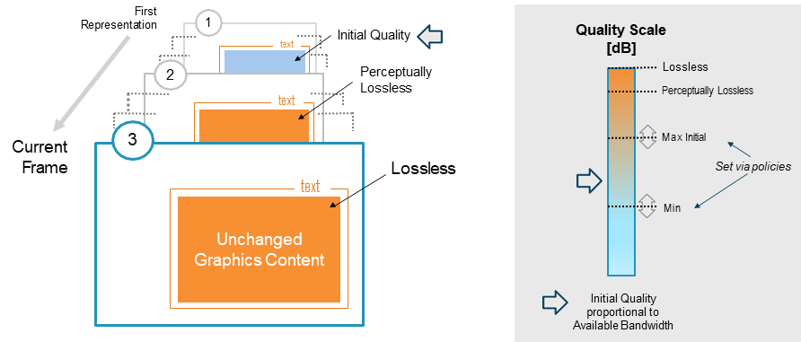
Unique Build-to-Lossless Technology
PCoIP simply ‘works’ on any network, thanks to unique image quality controls that ensure text and lines always remain crisp while intelligent algorithms operate in the background to maintain other content at the highest possible fidelity supported by your network. Unlike other protocols, PCoIP transitions seamlessly to 100% lossless without bursty retransmission of image content.

Slide 10
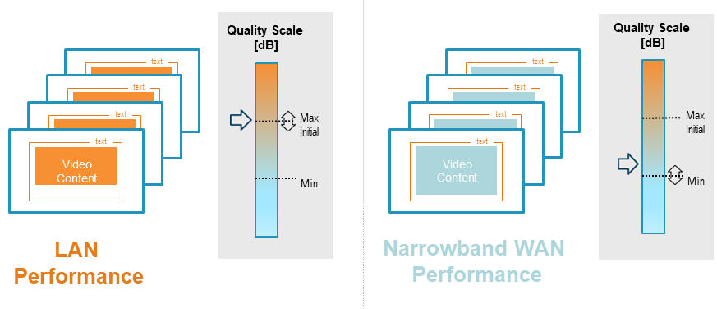
Dynamic Network Adaptation
PCoIP continuously senses the network availability and predicts optimum image quality and frame rate in real-time, always preserving the crisp nature of text and fine details. This means that under challenging sporadic congestion, PCoIP dynamically scales accordingly in real-time too.

Slide 11
Artist Experience Acceleration
PCoIP client devices, including zero clients can be configured for ‘local termination’ of Wacom Cintiq or Intuos devices – accelerating user interactivity for graphics artists, independent of the latency introduced by the network connection. Local termination minimizes visible lag by immediately reflecting the stylus position on the display while coordinates are being communicated back and forth with the host.

Slide 12
PCoIP Ultra for CPU or GPU Codec Acceleration
With the release of PCoIP Ultra™ enhancements, PCoIP is the only protocol that offers multi-codec acceleration via either CPU-based AVX2 hardware or NVIDIA GPU-based NVENC hardware.
SSE4.2 Original
Uses CPU
Uses
NVIDIA GPU
NVENC

Slide 13
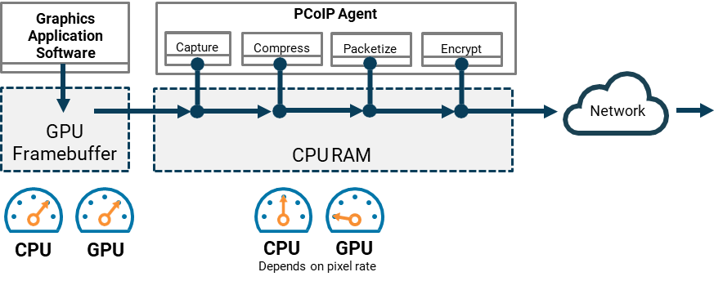
PCoIP Ultra CPU Optimizations
PCoIP Ultra CPU Optimizations leverage the AVX2 instruction set of modern multi-core servers to offer the color accuracy and Build-to-Lossless benefits embraced by millions of PCoIP users. AVX2 Acceleration extends PCoIP to 4K/UHD display resolution and high frame rates while preserving most CPU cycles which are required for high performance software applications.

Slide 14
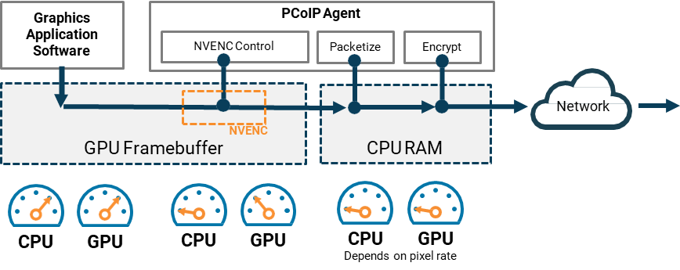
PCoIP Ultra GPU Optimizations
PCoIP Ultra GPU Optimizations leverage the NVIDIA NVENC encoder for H.264 or HEVC image compression which offers CPU relief when working with processing-hungry applications such as CPU render engines. The NVENC encoder can also be configured for H.264 4:2:0 chroma sub-sampling which offers significant network bandwidth savings when operating video-centric workloads over narrowband WAN networks.

Slide 15
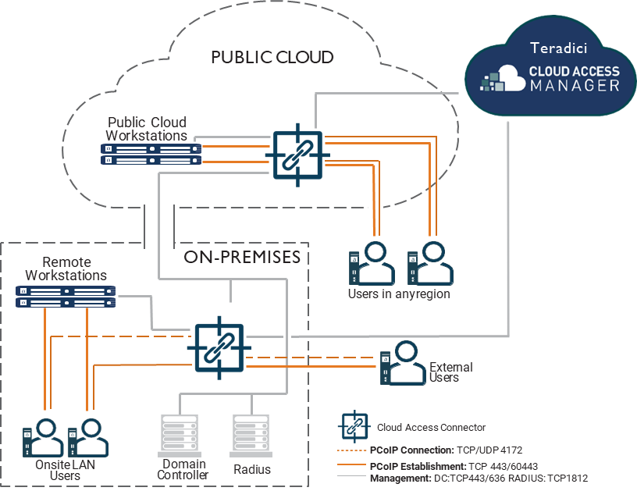
Cloud Access Manager for Online Deployments
Teradici Cloud Access Manager simplifies and automates deployments of Cloud Access Software by brokering PCoIP connections to remote Windows or Linux desktops and workstations, all from a single administration console.
Enables highly scalable and cost-effective deployments while enabling secure user entitlements and management of cloud compute costs.
Included with your Teradici Cloud Access Software license.
Anticipates future connection scenarios, allowing extension of capabilities from on-premises to cloud based remote workstations or hybrid scenarios at own pace.
Rapid deployment scripts for public clouds available on GitHub.

Slide 16
Offline Deployment Options
Teradici Connection Broker APIs and SDKs
Teradici offers a flexible set of APIs and SDKs enabling customers to develop turnkey workflows and customized production environments. You can choose self-integration or leverage our Professional Services Team to assist solving your unique production challenges.
Leostream, Virtual Cable and ClearCube Connection Brokers
Leostream offers robust Cloud Access Software connection management from a single console, including a range of advanced security and provisioning features suited to dark site and offline infrastructure required for government IT deployments. Virtual Cable UDS Enterprise is a multiplatform broker to manage Windows and Linux virtual desktops hosted in data center or in the cloud. ClearCube Sentral allows PCoIP Zero Client users to log in from anywhere.

Slide 17
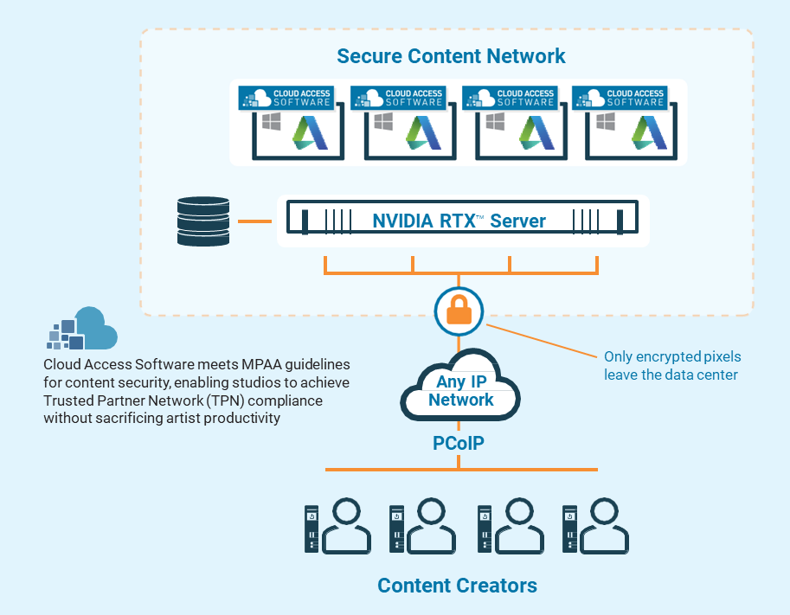
Reference Architecture: Real-time Ray-tracing with NVIDIA RTX and Autodesk
Content creators, studios and software vendors are rethinking traditional workflows in pursuit of optimized workflows that leverage latest graphics platforms. With the release of Autodesk Maya 2020 and Arnold 6 come new GPU-accelerated capabilities, giving creative professionals the speed and interactivity needed to iterate faster on projects, shorten the review and approval loop, and get jobs done on time. From real-time look development to final-frame rendering, Arnold 6 can be now be used for full production rendering with NVIDIA RTX GPUs and RTX Server.
Teradici Cloud Access Software ensures that the RTX user experience comes without compromise – while studios can leverage PCoIP technology for conformance with MPAA content security guidelines and achieve Trusted Partner Network (TPN) compliance.

Slide 18
Get Started Today
Teradici Cloud Access Software, including Standard and Graphics editions are available for download with trial licenses for Windows or Linux platforms. You can install the trial on physical, virtualized or cloud-based remote workstations.
Teradici Cloud Access Manager is now available for AWS, Microsoft Azure, Google Cloud, Nutanix AHV, KVM or VMware ESXi. To deploy the solution in a public cloud, bring your own public cloud subscription.
SIGN UP FOR YOUR FREE TRIAL
teradici.com/cas-demo
REQUEST A DEMO
teradici.com/contact-us
TO LEARN MORE VISIT
teradici.com/cloud-access-software

